Slide 1
Parallel Computers
Chapter 1

Slide 2
Demand for Computational Speed
There is continual demand for greater computational speed
Areas requiring great computational speed include numerical modeling and simulation of scientific and engineering problems.
Computations must be completed within a “reasonable” time period.

Slide 3
Grand Challenge Problems
One that cannot be solved in a reasonable amount of time with today’s computers. Obviously, an execution time of 10 years is always unreasonable.
Examples
Modeling large DNA structures
Global weather forecasting
Modeling motion of astronomical bodies.

Slide 4
Example: Global Weather Forecasting
Atmosphere modeled by dividing it into 3-dimensional cells. Calculations of each cell repeated many times to model passage of time.
Suppose whole global atmosphere (5 × 10⁸ sq.miles) divided into cells of size 1 mile × 1 mile × 1 mile to a height of 10 miles (10 cells high) ➔ 50 × 10⁸ cells.
Suppose each calculation requires 2000 FLOPs (floating point operations). In one time step, 10¹³ FLOPs necessary.
To forecast the weather over 7 days using 1-minute intervals, a computer operating at 10 Gflops (10¹⁰ floating point operations/s) takes 10⁷ seconds or over 115 days.
To perform calculation in 50 minutes requires a computer operating at 34 Tflops (34 × 10¹² floating point operations/sec).
(IBM Blue Gene is ~500 TFLOPS)

Slide 5
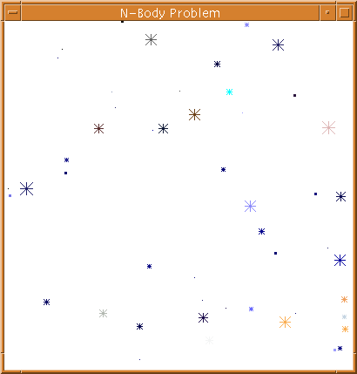
Modeling Motion of Astronomical Bodies
    Each body attracted to each other body by gravitational forces. Movement of each body predicted by calculating total force on each body.
    With N bodies, N - 1 forces to calculate for each body, or approx. N² calculations. (Nlog₂N for an efficient approx. algorithm). After determining new positions of bodies, calculations repeated.
A galaxy might have 10¹¹ stars.
If each calculation is done in 10⁻⁹ sec., it takes 10¹³ seconds for one iteration using N² algorithm (or 10¹³/86400 ≅10⁸ days)
10³ sec. for one iteration using the Nlog₂N algorithm.

Slide 6
Parallel Computing
Using more than one computer, or a computer with more than one processor, to solve a problem.
Motives
n computers operating simultaneously can achieve the result n times faster - it will not be n times faster for various reasons.
Other motives include: fault tolerance, larger amount of memory available, ...

Slide 7
Speedup Factor
Execution time using one processor (best sequential algorithm)
t_{s}
S(p) =
=
t_{p}
Execution time using a multiprocessor with p processors
where t_{s} is execution time on a single processor and t_{p} is execution time on a multiprocessor.
S(p) : increase in speed by using multiprocessor.
Use best sequential algorithm with single processor system. Underlying algorithm for parallel implementation might be (and is usually) different.
Speedup factor can also be cast in terms of computational steps:
Number of computational steps using one processor
S(p) =
Number of parallel computational steps with p processors

Slide 8
**here
Maximum Speedup
Maximum speedup is usually p with p processors (linear speedup).
Possible to get superlinear speedup (greater than p) but usually there is a specific reason such as:
  Extra memory in multiprocessor system
  Nondeterministic algorithm

Slide 9
Maximum Speedup
Amdahl’s law
t_{s}
ft_{s}
(1-f)t_{s}
Serial section
Parallelizable sections
. . .
(a) One processor
(b) Multiple
processors
. . .
p processors
t_{p}
(1-f)t_{s} / p

Slide 10
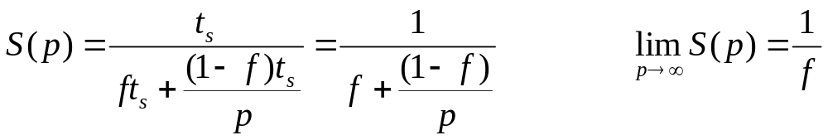
Speedup factor is given by:
This equation is known as Amdahl’s law.
Even with infinite number of processors, maximum speedup is limited to 1/f.
Example: With only 5% of computation being serial, maximum speedup is 20, irrespective of number of processors.

Slide 11
Superlinear Speedup
Example - searching
(a) Searching each sub-space sequentially
Start
Time
t
s
t_{s}/p
Sub-space
search
Δt
xt_{s}/p
Solution found
x indeterminate

Slide 12
(b) Searching each sub-space in parallel
Speed-up then given by
t
s
x
×
Δ
p
+
t
S(p)
=
Δ
t
Δt
Solution found

Slide 13
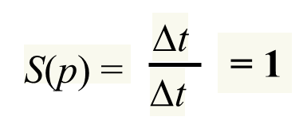
Worst case for sequential search when solution found in last sub-space search. Then parallel version offers greatest benefit, i.e.
p - 1
×
t_{s}
+
Δt
p
S(p)
=
→
∞
as Δt tends to go to zero
Δt
Least advantage for parallel version when solution found in first sub-space search of the sequential search, i.e.
Actual speed-up depends upon which subspace holds solution but could be extremely large.

Slide 14
Conventional Computer
Consists of a processor executing a program stored in a (main) memory:
Addresses start at 0 and extend to 2^{b} - 1
Main memory
Instr
uctions (to processor)
Data (to or from processor)
Processor

Slide 15
Shared Memory Multiprocessor System
Parallel Computers
Shared memory vs. Distributed memory
Multiple processors connected to multiple memory modules such that each processor can access any memory module :
Memory module
One
address
space
Interconnection
network
Processors

Slide 16
Quad Pentium Shared Memory Multiprocessor
Processor
Processor
Processor
Processor
L1 cache
L1 cache
L1 cache
L1 cache
L2 Cache
L2 Cache
L2 Cache
L2 Cache
Bus interface
Bus interface
Bus interface
Bus interface
Processor/
memory
b
us
I/O interf
ace
Memory controller
I/O b
us
Shared memory
Memory
Need to address Cache coherency problem!

Slide 17
Shared Memory Multiprocessors
Threads - programmer decomposes program into individual parallel sequences, (threads), each being able to access shared variables.
Sequential programming language with preprocessor compiler directives to declare shared variables and specify parallelism.
Example: OpenMP - industry standard - needs OpenMP compiler

Slide 18
Message-Passing Multicomputer
Complete computers connected through an interconnection network:
Interconnection
network
Messages
Processor
Local
memory
Computers

Slide 19
Interconnection Networks
2- and 3-dimensional meshes
Hypercube
Trees
Using Switches:
  Crossbar
  Multistage interconnection networks

Slide 20
Two-dimensional array (mesh)
One-dimensional array
Links
Computer/Processor
Links

Slide 21
Ring
Two-dimensional Torus

Slide 22
Three-dimensional hypercube
110
111
100
101
010
011
000
001

Slide 23
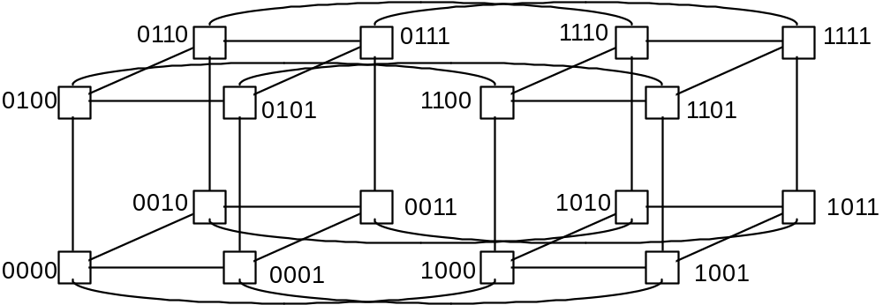
Four-dimensional hypercube
Hypercubes were very popular in 1980’s

Slide 24
Tree
Root
Links
Switch
element
Processors

Slide 25
Crossbar switch
Memor
ies
Processors
Switches

Slide 26
Multistage Interconnection Network
Example: Omega network
2
x
2 switch elements
Inputs
(straight-through or
crossover connections)
Outputs
000
000
001
001
010
010
011
011
100
100
101
101
110
110
111
111

Slide 27
Embedding a ring onto a hypercube
110
111
100
101
010
011
000
001
000 001 011 010 110 111 101 100
What is this sequence called?
3-bit Gray Code

Slide 28
Embedding a 2-D Mesh onto a hypercube
11
01
00
11 0110
01 0110
01 0111
0000 0001 0011 0010 0110 0111 0101 0100 1100 1101
2-bit graycode
4-bit graycode

Slide 29
Distributed Shared Memory
Making main memory of group of interconnected computers look as though a single memory with single address space. Then can use shared memory programming techniques.
Interconnection
netw
or
k
Messages
Processor
Shared
memory
Computers

Slide 30
Flynn’s Classifications
Flynn (1966) created a classification for computers based upon instruction streams and data streams:
  SISD - Single Instruction stream- Single Data stream
Single processor computer - single stream of instructions generated from program. Instructions operate upon a single stream of data items.

Slide 31
MIMD: Multiple Instruction Stream-
Multiple Data Stream
Each processor has a separate program and a separate (independent) thread of execution. Typically, instructions in separate processors operate upon different data.
Both the shared memory and the message-passing multiprocessors so far described are in MIMD classification.
SIMD: Single Instruction Stream-
Multiple Data Stream
Each processor executes same instruction in synchronism, but using different data. A single instruction stream from a single program is broadcast to all processors
Many applications operate upon arrays of data

Slide 32
MPMD - Multiple Program Multiple Data
Within the MIMD classification, each processor will have its own program to execute:
Program-1
Program-N
Instructions
Instructions
Processor-1
Processor-N
Data
Data

Slide 33
SPMD - Single Program Multiple Data
Single source program written and each processor executes its personal copy of this program, although independently and not in synchronism.
Source program can be constructed so that parts of the program are executed by certain computers and not others depending upon the identity of the computer.

Slide 34
Networked Computers as a Computing Platform
A network of computers became a very attractive alternative to expensive supercomputers and parallel computer systems for high-performance computing in early 1990’s.
Notable early projects:
  Berkeley NOW (network of workstations).
  NASA Beowulf project.
Key Advantages:
Very high performance workstations and PCs readily available at low cost.
The latest processors can be easily incorporated into the system as they become available.
Existing software can be used or modified.

